Slide 1
Virtual Art Gallery And Auction Platform

Slide 2
Group number : 6
Guide name: Nitin Sakhare.
Group members:
Name | Gr number | Roll Number
Pranjali Sathe | 21910713 | 421051
Vaishnavi Bhavsar | 21910446 | 421008
Shital Bambale | 17u286 | 421074

Slide 3
I. Introduction
It is a website developed for the artists and the art lovers. It is a place where artists can put their products for sell and customers can visit the website and purchase these beautiful art and craft products to decorate their houses.This website is very user friendly and easy to use. Anyone with minimum technical knowledge can handle this website and order the desired paintings

Slide 4
2. Literature Survey
Both online art galleries and online auction platforms have become increasingly popular in recent years.
Variety of paintings are not readily available in the local galleries.
It is difficult to find the paintings we need .
Platforms have increased the accessibility and transparency of the art market, making it easier for both buyers and sellers to participate.
Overall, the literature on online art galleries and auction platforms suggests that these platforms have had a significant impact on the art market and have enabled a wider range of people to participate in buying and selling art.

Slide 5
3. Aim of Project
The Online Art Gallery has been developed to override the problems prevailing in the practicing manual system.
Users need to go to the nearest market to purchase product. This will take time.Products related to art are difficult to find in the nearest art galleries in the area and it is not certain if the category of that painting is available at the particular gallery. Users also find it difficult to track purchased painting. This portal makes it easy for users to track their paintings. The paintings are available directly on the portal, so the cost of the paintings is relatively lower than in local art galleries.
.

Slide 6
4. Objectives
1. Provides user friendly platform.
2. Variety of different paintings with details .
3. Platform can show the latest paintings on the portal and the customers can automatically get to know about various paintings and trends.
4. Online payment methods .
5.Contact methode for any inquiry.
6.Platform can support different devices.

Slide 7








6.Software specifications:
Tool Used:
Vs code
React JS
redux
react-bootstrap
Postman

Slide 8
6.advantages of new system over existing system
1. Time saver
2. Make comfortable
3. Shipping and delivery
4. Discounts and offer
5. Payment options
6. Sales
7. Distance
8. Good value for quality work

Slide 9
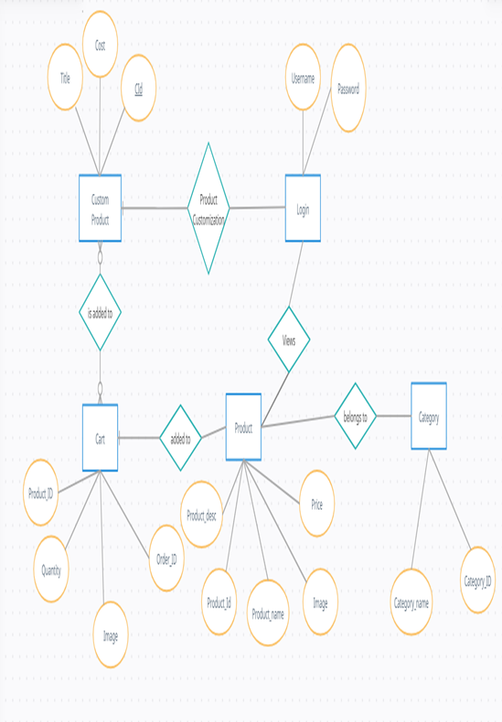
7.Architecture Diagram/Block Diagram
of your system

Slide 10
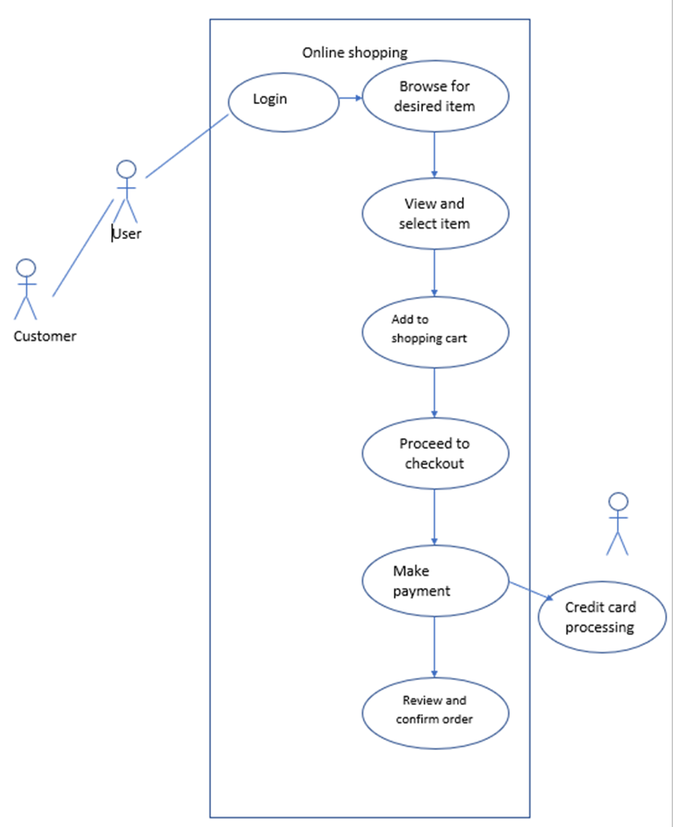
8. Use case diagrams

Slide 11
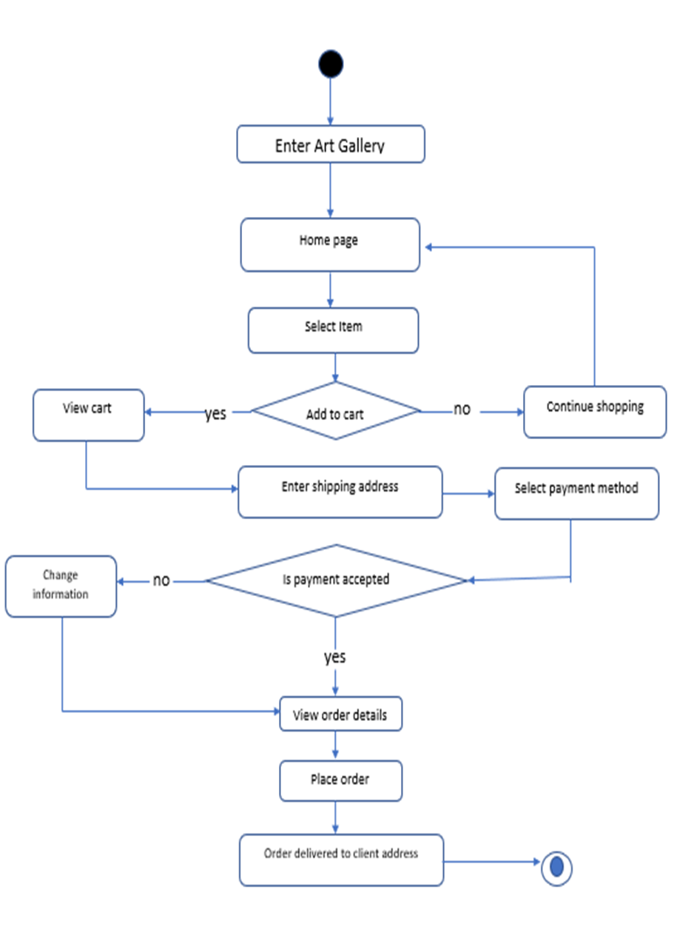
9..PROCESS FLOW DIAGRAM

Slide 12
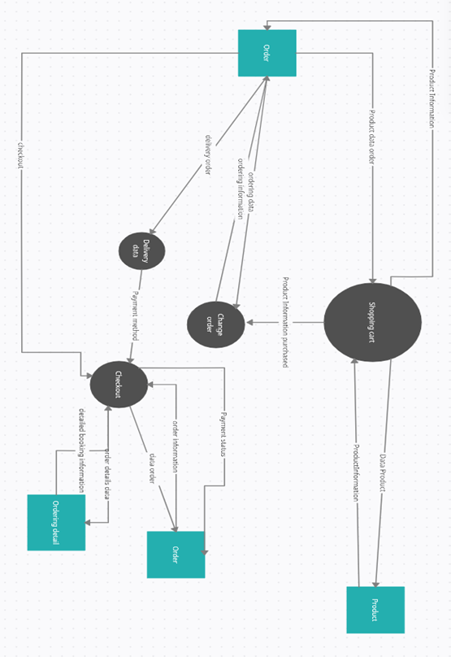
9..PROCESS FLOW DIAGRAM

Slide 13
10. Challenges for your project
Competition: There may be many other virtual art galleries and auction platforms that are competing for the same audience.
Trust: It can be challenging to establish trust with buyers and sellers on the platform,
Authenticity: Ensuring the authenticity of the artworks being sold on the platform is important,
Payment security: Ensuring that payment transactions are secure is crucial for any online platform,
Shipping and handling: Shipping and handling artworks can be a delicate process,
User experience: Creating a user-friendly and intuitive platform that is easy.
Marketing: Marketing the platform and promoting artworks effectively can be challenging,

Slide 14
11. Implementation details
User management You will need to design a system for registering and authenticating users
Artwork catalog you will need to create a system for storing and organizing information about the artworks
Bidding and auction management If you are planning to offer auction-style sales
Payment processing You will need to integrate with a payment processing service in order to handle transactions on your platform.
Content management You will need to create a system for managing the content on your platform
Security It is important to prioritize security in the design and implementation of your platform

Slide 15
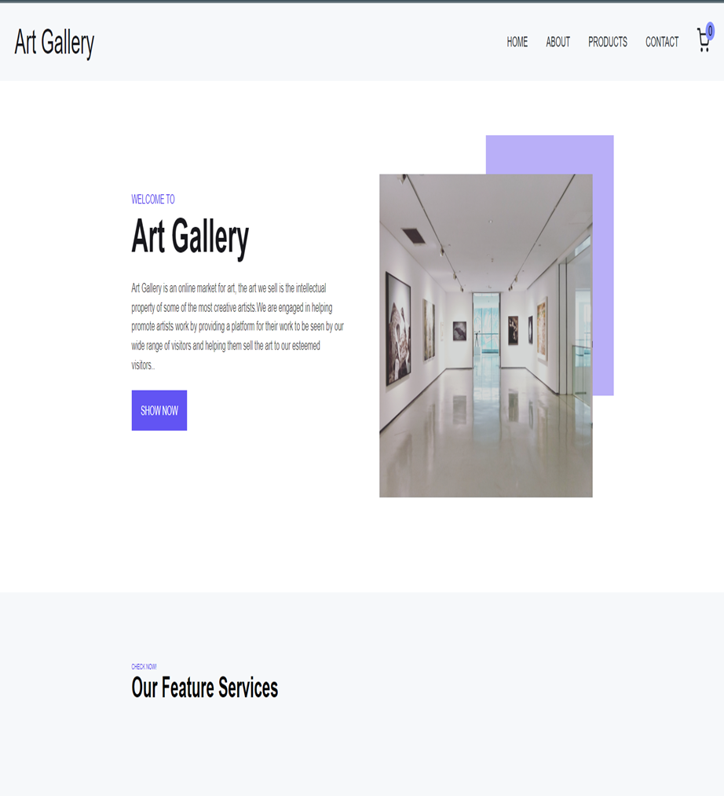
12. Results
Home Page:This is default page when anyone visits our website address.

Slide 16
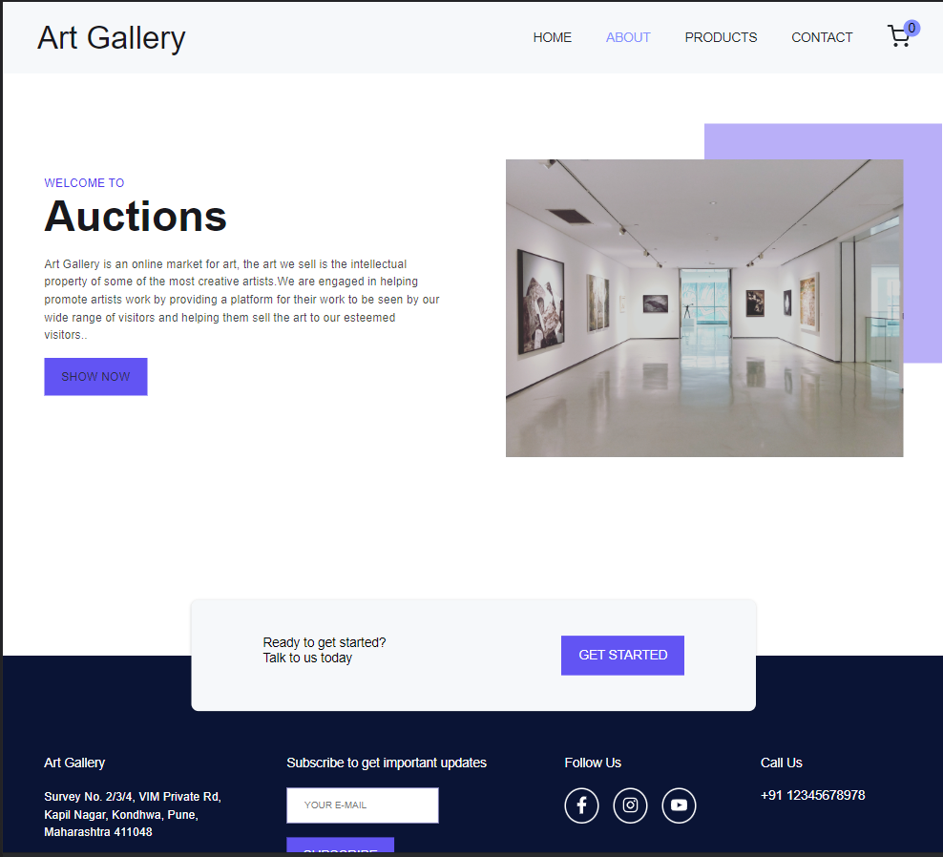
About Page:This is displays the details about website.

Slide 17
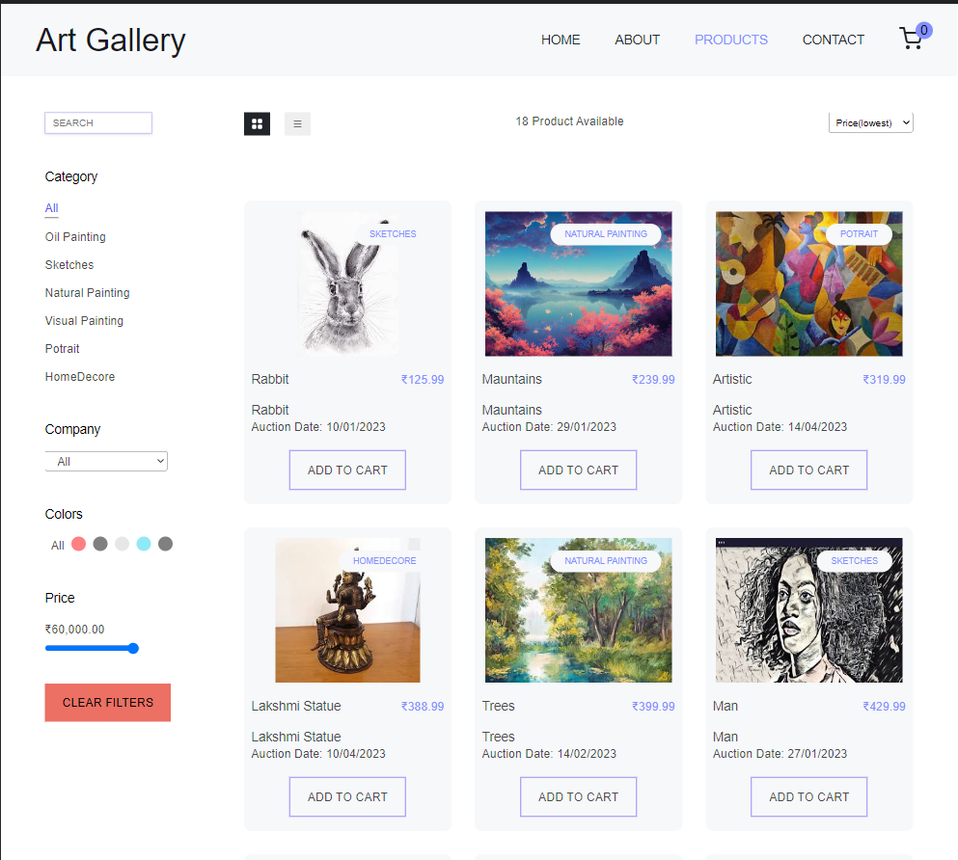
PRODUCTS : Details about the product are on this page. Users can search the desired paintings using different filtering methods like category ,price,colors etc.

Slide 18
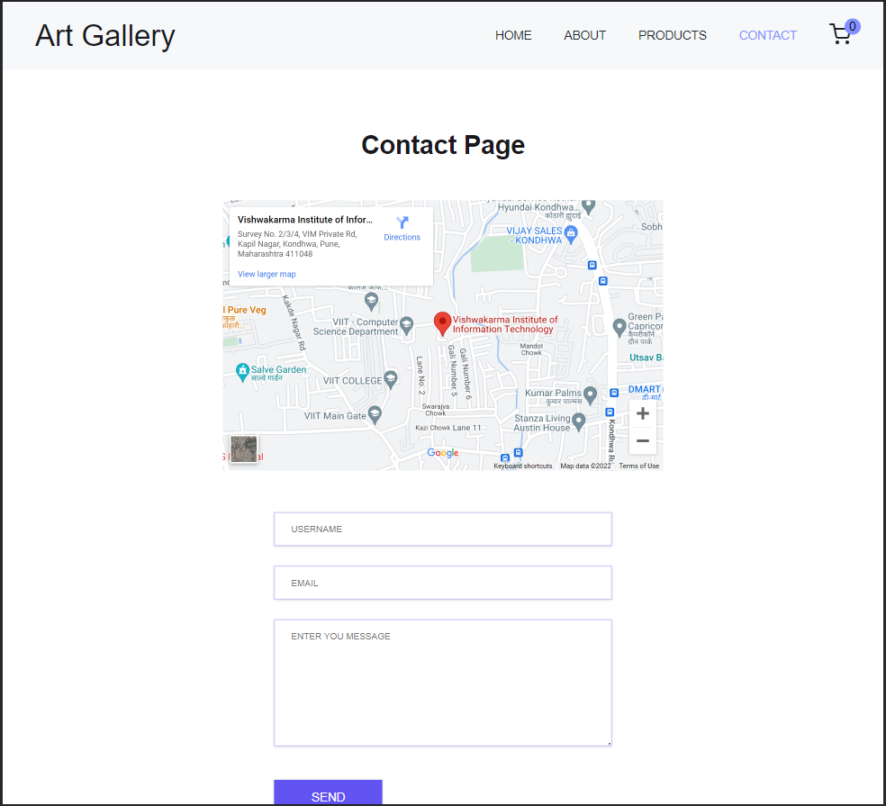
Contact Page:This page displays the location of gallery and the message box to contact .

Slide 19
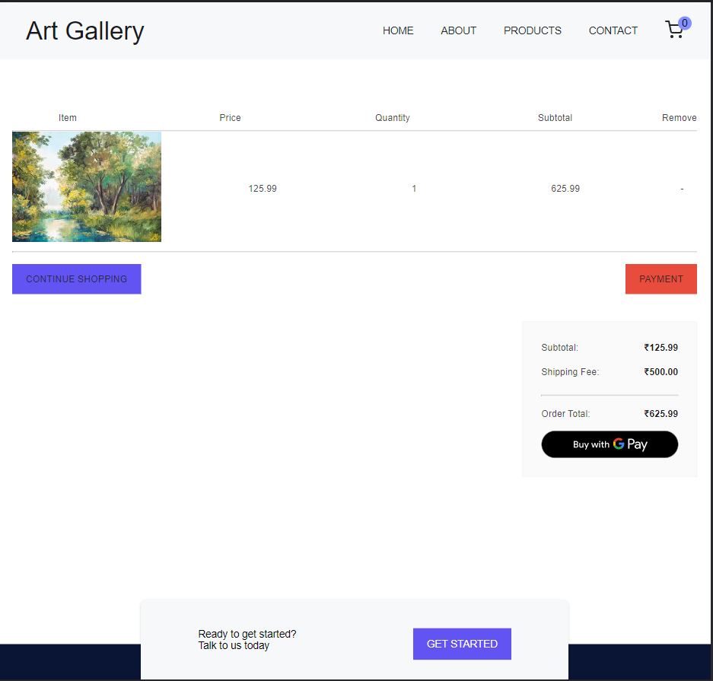
ORDER PAGE : Here, users can place orders for desired goods.

Slide 20
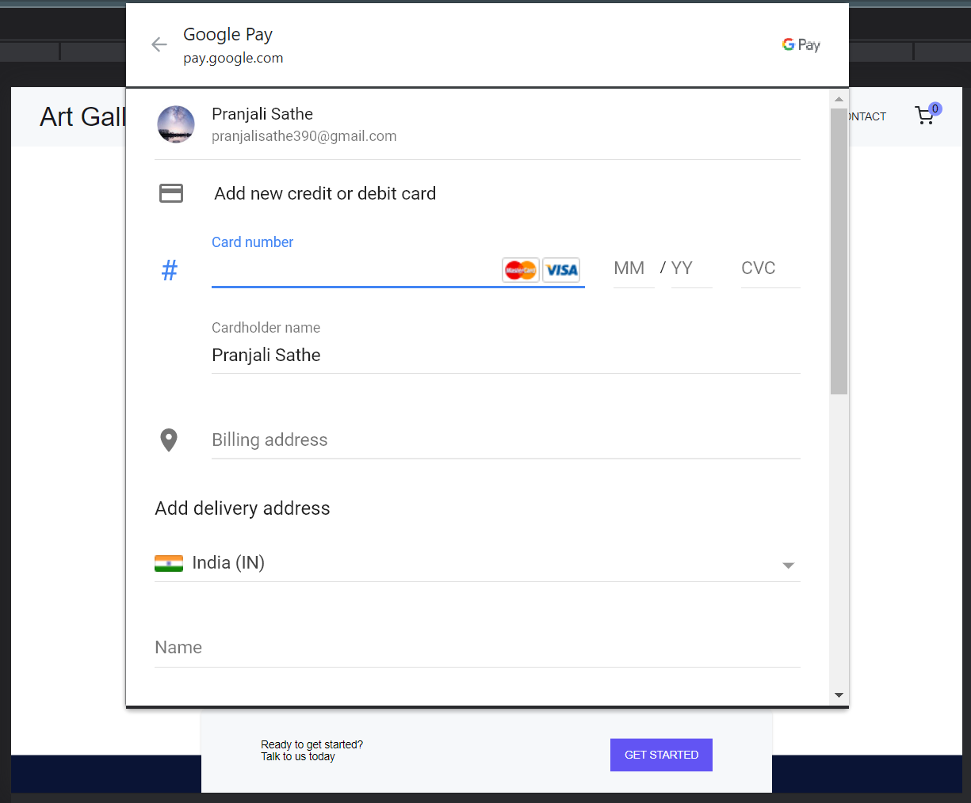
Payment Gateway :using google pay Display shifts payment method to transaction accepted Select cash on delivery ,Promoted to payment accepted.
.

Slide 21
13. Applications
A virtual art gallery and auction platform is a digital platform that allows artists and art collectors to view and purchase artworks online.
gallery and auction platform is that it provides a convenient and accessible way for artists and art collectors to connect and transact.
a virtual art gallery and auction platform may also allow users to browse and purchase digital art, such as digital paintings.

Slide 22
14. Conclusions
This was the our presentation for our E-Commerce website ‘ArtGallery’. We have tried our best to make the website robust, efficient and less time consuming. We have also tried to make it as dynamic as possible. The entire system is secured. This website achieves all the desired functionalities expected in the problem statement.
• Made statement of the aims and objectives of the project
• The description of Purpose, Scope, and applicability
• We define the problem on which we are working in the project.
• We describe the requirement Specifications of the system and the actions that can be done on these things.
• We understand the problem domain and produce a model of the system, which describes operations that can be performed on the system.

Slide 23
15. Future work (if any)
Nothing is ever completely done. So a lot of aspects have been considered which reflect in the mentioned future scope:This is a small website designed for just one organization.
This website can be expanded to a large scale and various other Art Galleries or Artists sell their products through this portal.
The website can be designed in such a way that the paintings in demand can
be displayed first before the other products.
We can also implement live countdown timer for auction date.
We can store the records of painting and using AI can recommend the paintings.

Slide 24
16. References( Standard format)
• [1]https://www.saffronart.com/
• [2] http://history-computer.com/Internet/Internet.html
• [3] https://en.wikipedia.org/wiki/Online_art_gallery
• [4] https://www.linkedin.com/pulse/online-art-gallery-revealing-featuresadvantages-faim-uddin-
• [5] http://www.huffingtonpost.com/jason-landry/why-galleries-areimporta_b_4074202.html
• [6] http://www.iamwire.com/2015/06/scope-online-art-marketplaceindia/118178
• [7] https://theabundantartist.com/online-art-galleries/
• [8] https://www.widewalls.ch/the-rise-of-online-art-market/
• [9] Read, R., 2017, Hiscox Online Art Trade Report 2017, Hiscox [Sep 12, 2017

Slide 25
Thank You!

